Slide 1
Creation of a software module for modeling the effective properties of ceramic composites
research work
Kirillov N. D. Mk-10

Slide 2



Introduction
Nowadays, composite materials are widely used in:
various industries such as aircraft building, shipbuilding, rocketry
various fields of medicine and biochemistry

Slide 3
My research work
The main purpose of my work is the numerical simulation of a ceramic composite of aluminum oxide with carbon nanotubes (Al₂O₃ – CNT)
Creation of a 3D model of the geometry of the material under study
Calculation of the strength, deformation and elastic properties of the composite
Analysis and optimization of the results

Slide 4
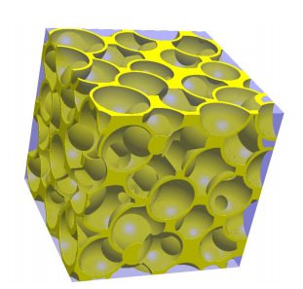
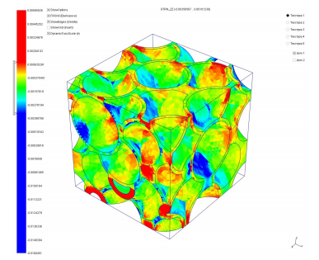
Cell of periodicity
This is a geometric representation of the studied material, which makes it possible to represent a complex multicomponent system in a simple form. Such cells are programmed in C ++, and then rendered using application programs.

Slide 5
Computing module
Computations and definitions of composite properties are based on the multiscale homogenization method. This method combines the finite element method(FEM) and the theory of continuum mechanics.
As input data, the periodicity cell will act, and the output data will be the strength and elastic properties of the ceramic composite.
The computing module will also be developed in C ++

Slide 6
Conclusion
At the end of the work, a software module will be developed that will allow calculating and predicting the mechanical properties of the ceramic composite Al₂O₃ – CNT.
It should be noted that the module will be universal and it will be possible to use it to calculate the characteristics of other composite materials.

